Slide 1

CEIS101 Course Project
CEIS101 Final Course Project
Session
Harrison Olvera
Prof. Ashley Gans-Forrest
Notes:
https://harrisonolvera.wixsite.com/hboportolfio

Slide 2


Introduction
In this project, the class builds an automated system utilizing the principles of technology and knowledge of IoT devices.
Create an automated device for:
Checking whether the door is closed or not
Monitor for a possible home intruder
Turning a light on automatically when it is dark
Tools used:
Arduino IDE – for implementing automated code
Tinkercad – for simulated testing
Microsoft Excel – for graphing data
Arduino IoT kit – for creating the automated device

Slide 3

Inventory of parts, circuit building, and code

Slide 4
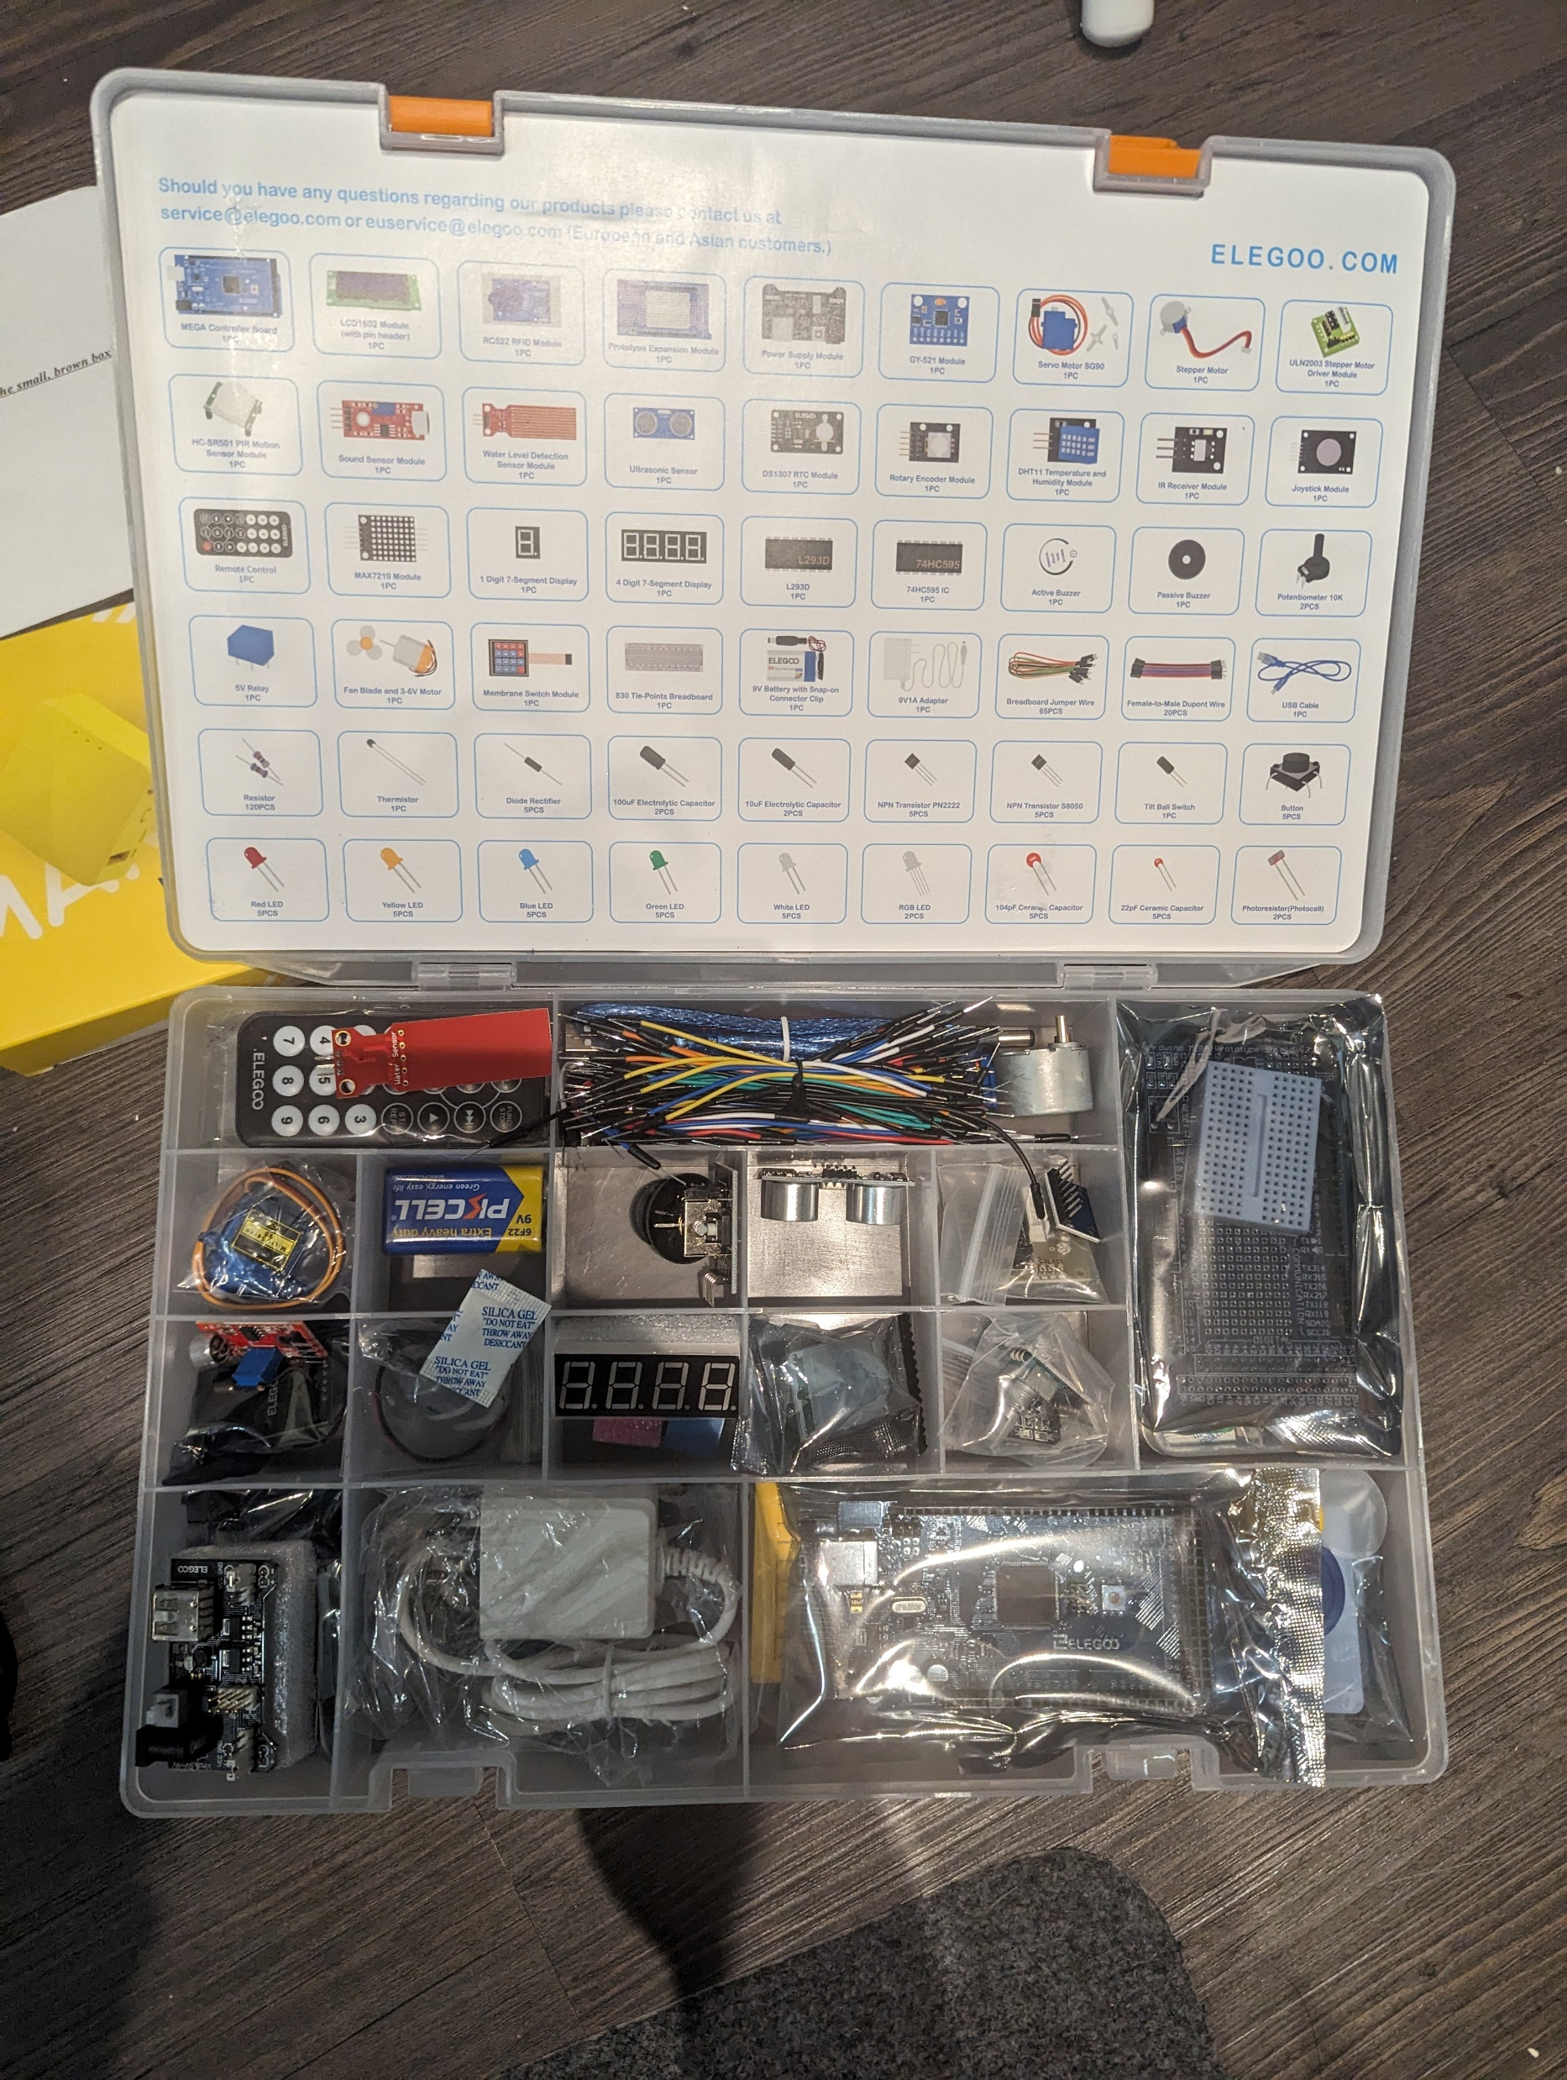
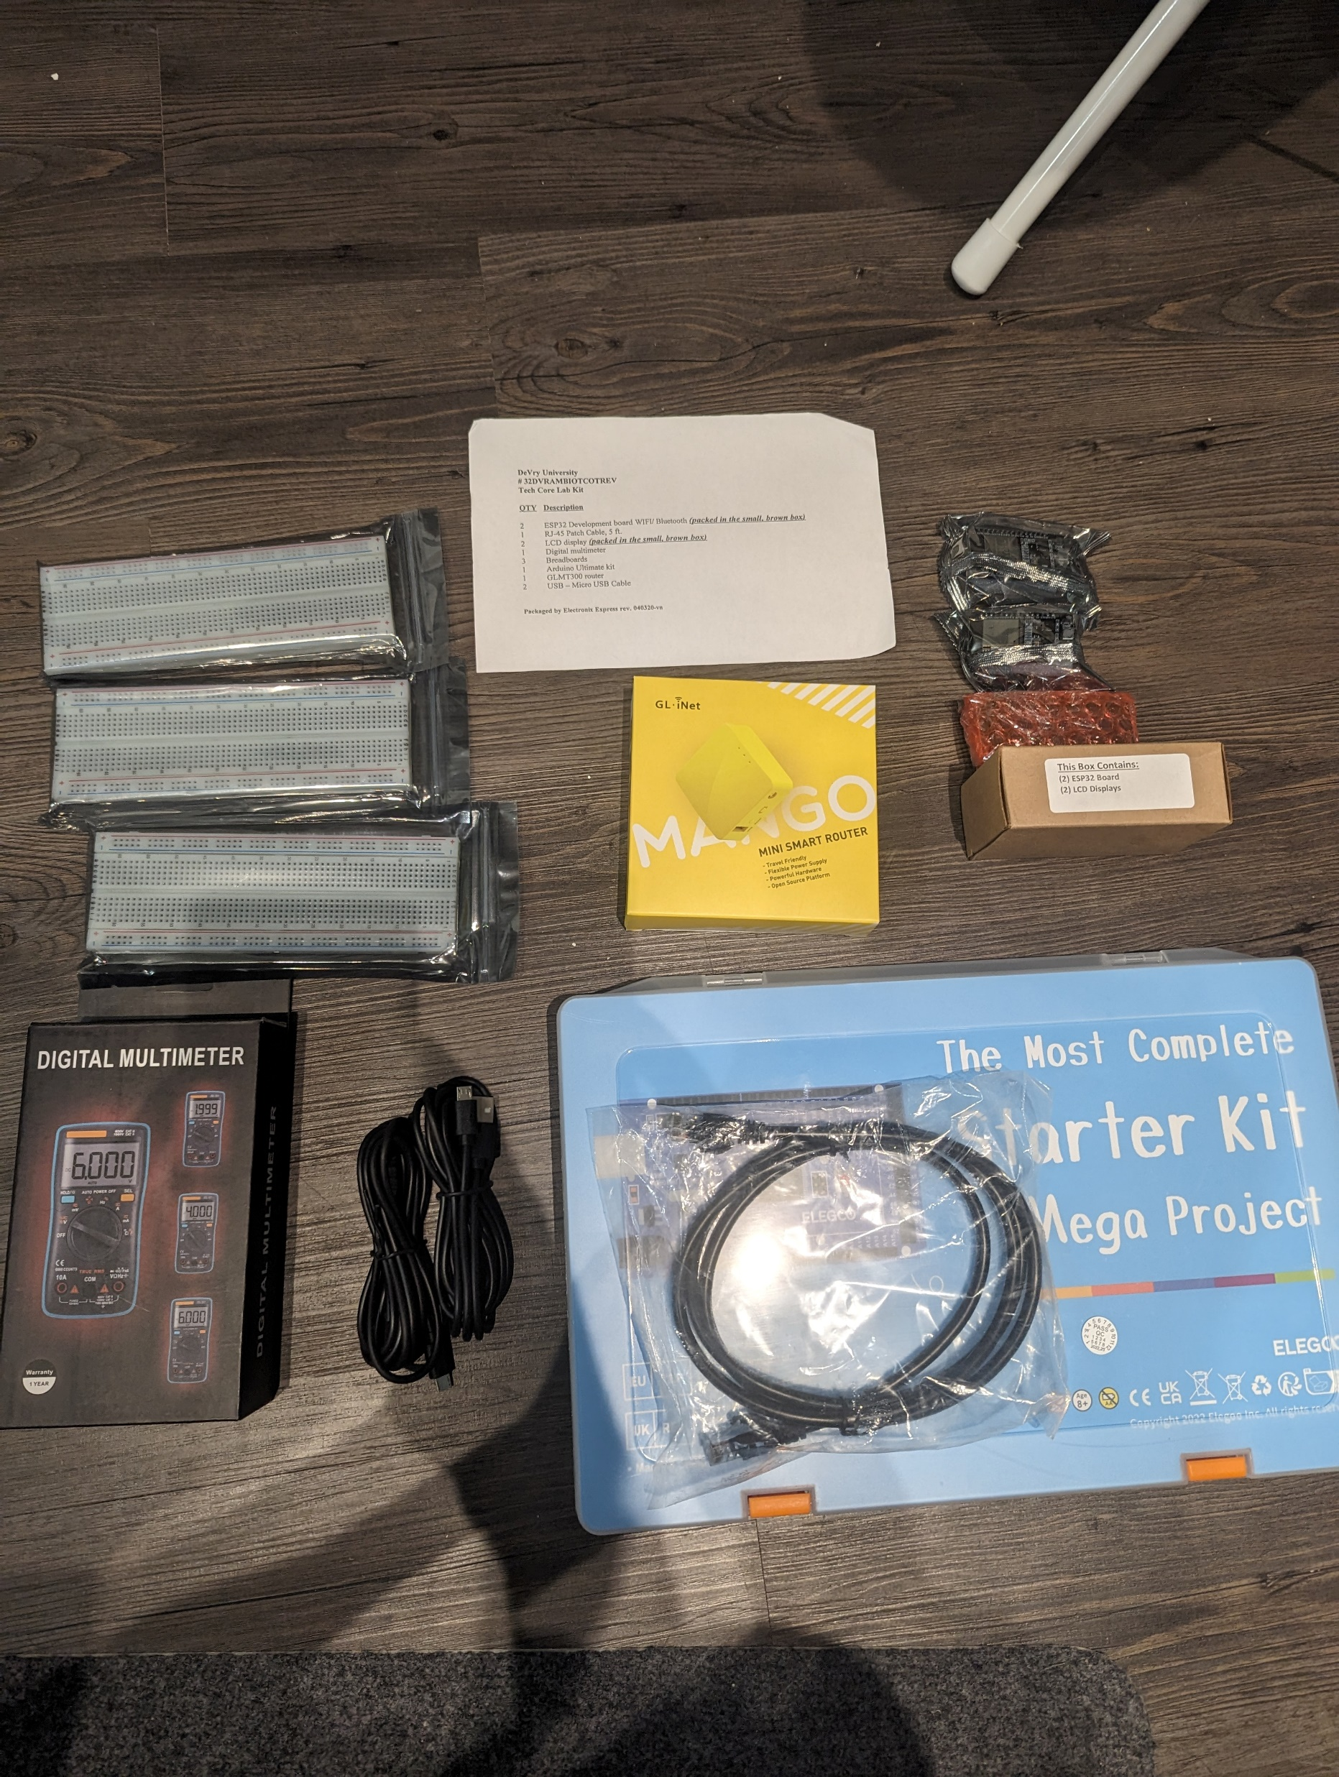
Inventory of iot kit (picture)
RJ-45 Patch Cable, 5 ft.
ESP32 (2)
LCD display (2)
Digital multimeter
Breadboards (3)
Arduino Ultimate kit
GLMT300 router
USB – Micro USB Cable (2)

Slide 5
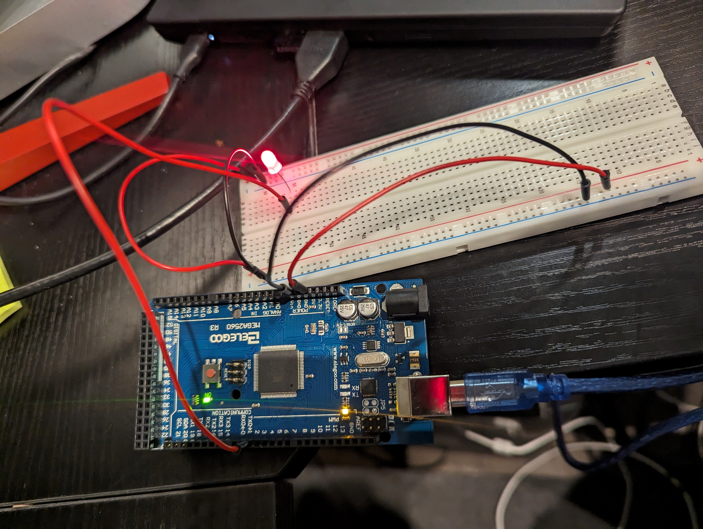
Circuit with red led on(picture)

Slide 6
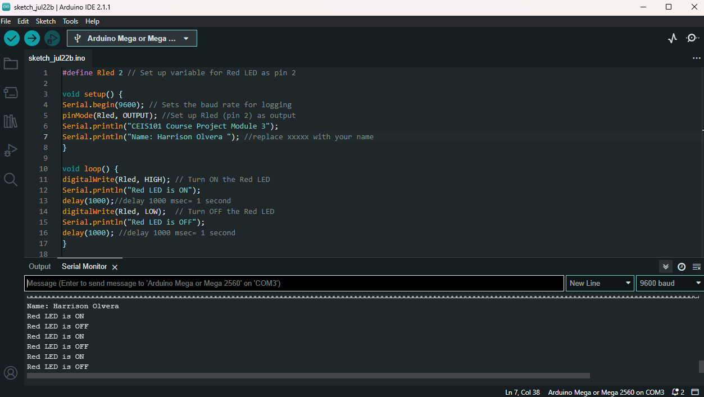
Serial monitor(picture)

Slide 7
adding door sensor to smart home system

Slide 8
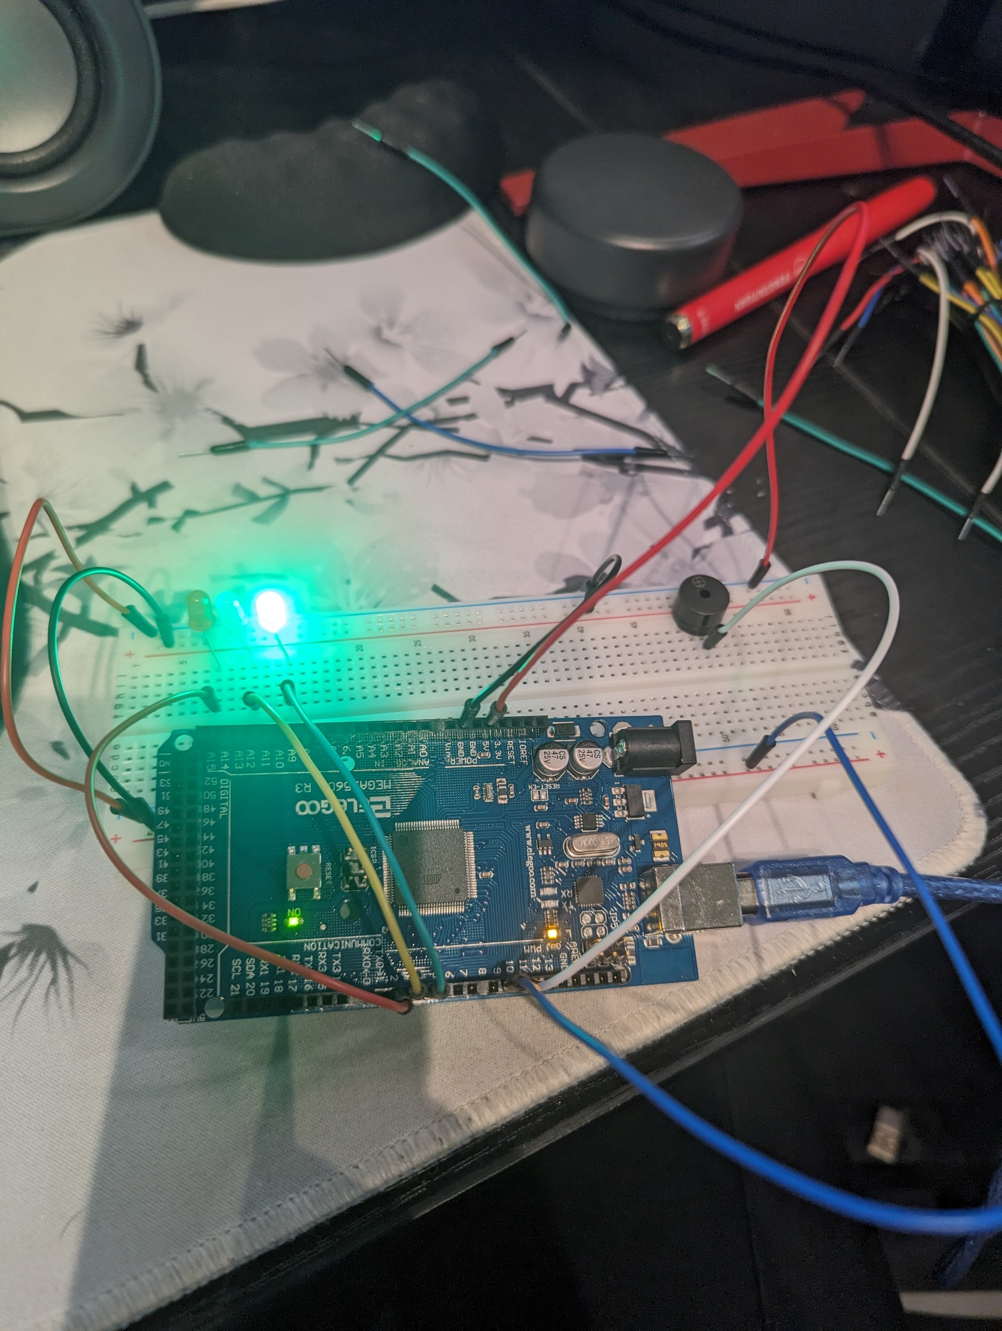
Circuit with door closed with green led on(picture)

Slide 9
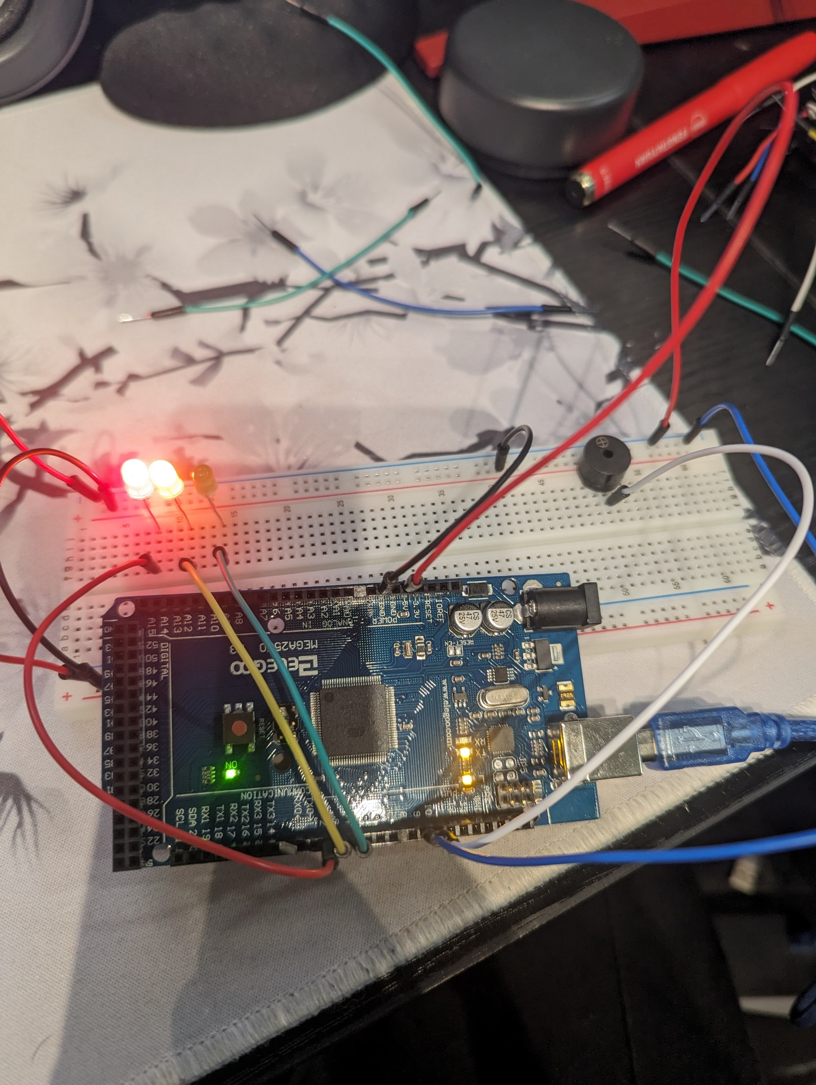
Circuit with door open with green led off(picture)

Slide 10
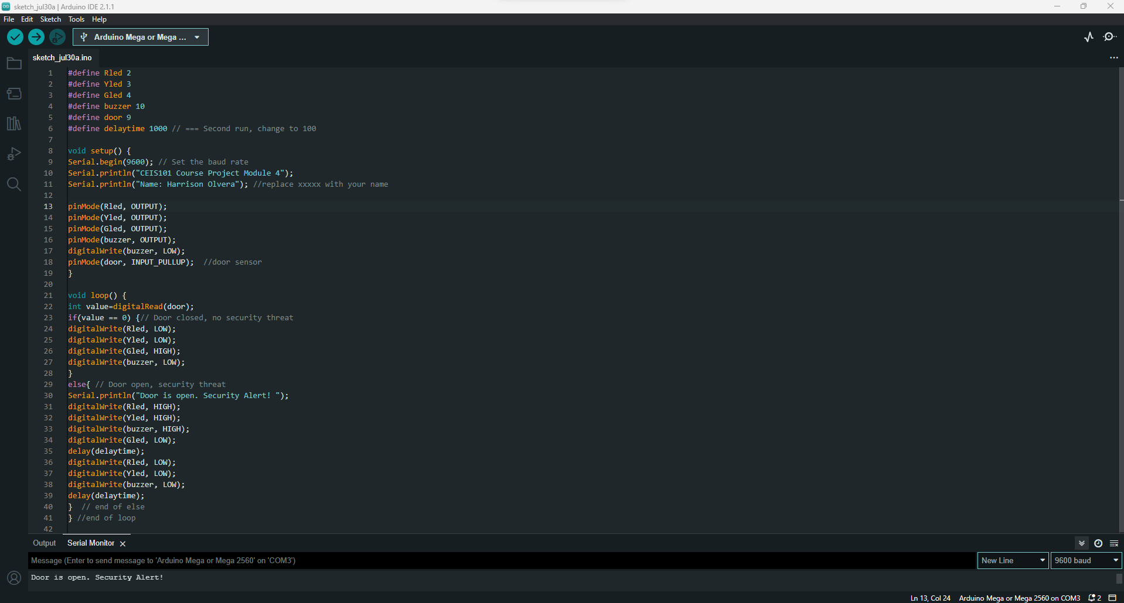
Arduino code (screenshot)

Slide 11
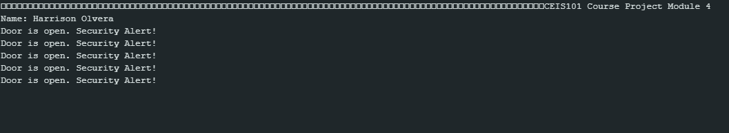
Serial monitor (screenshot)

Slide 12
adding distance sensor to smart home system and conducting data analysis

Slide 13
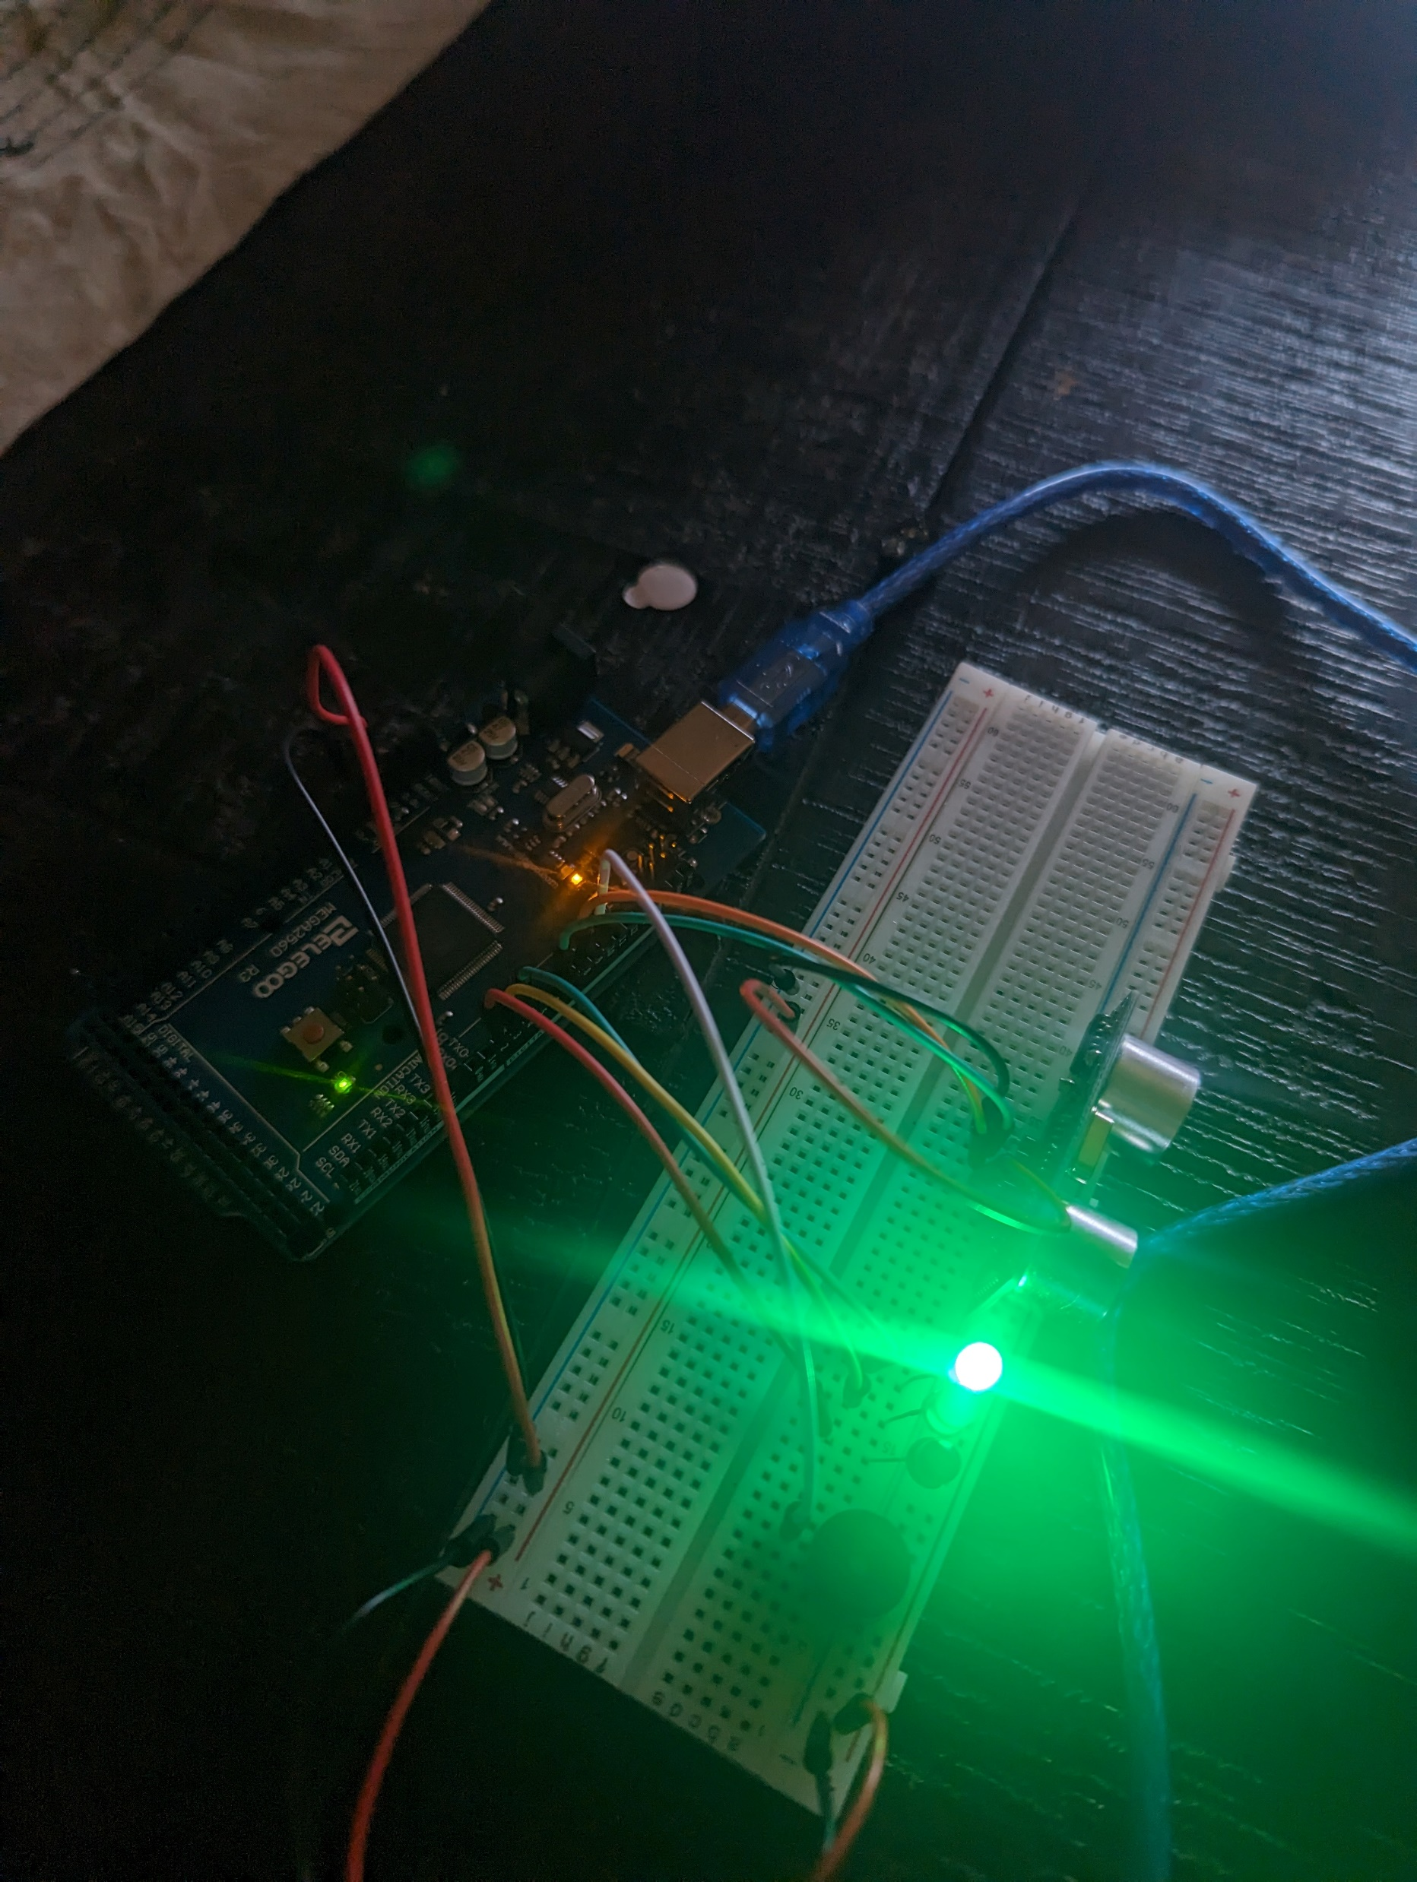
Circuit with green led on (picture)

Slide 14
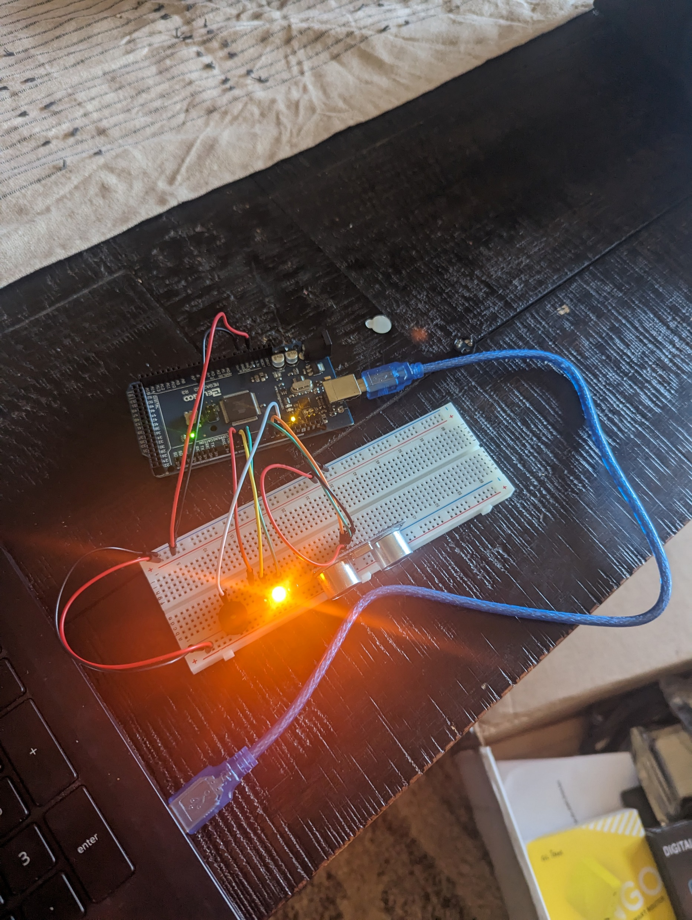
Circuit with yellow led on (picture)

Slide 15
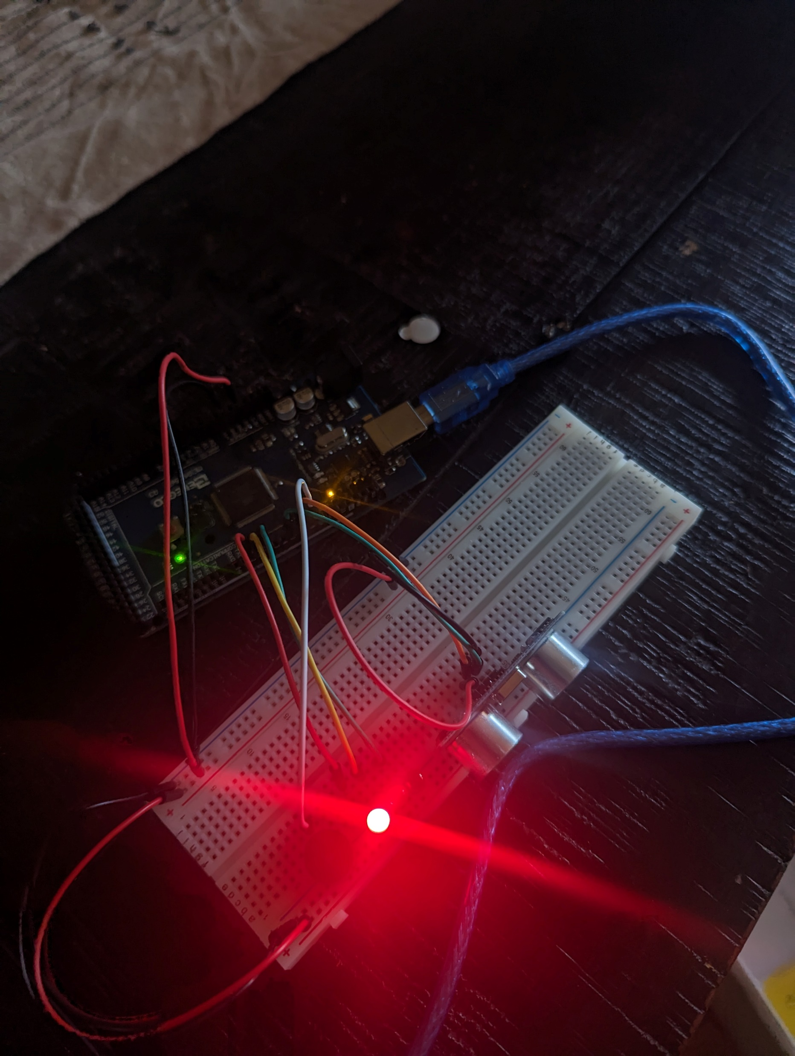
Circuit with red led on (picture)

Slide 16
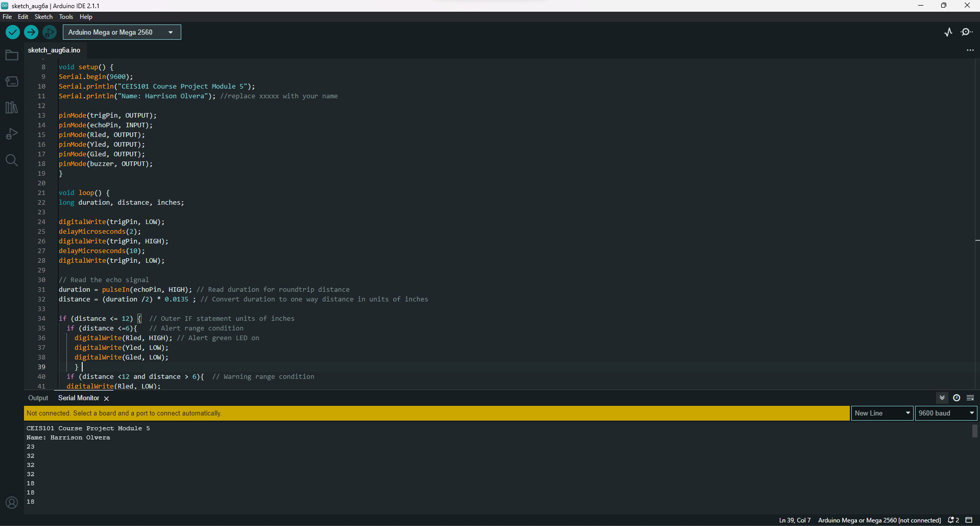
Arduino code (screenshot)

Slide 17
Plot of data (graph from excel)

Slide 18
adding automated light to smart home system

Slide 19
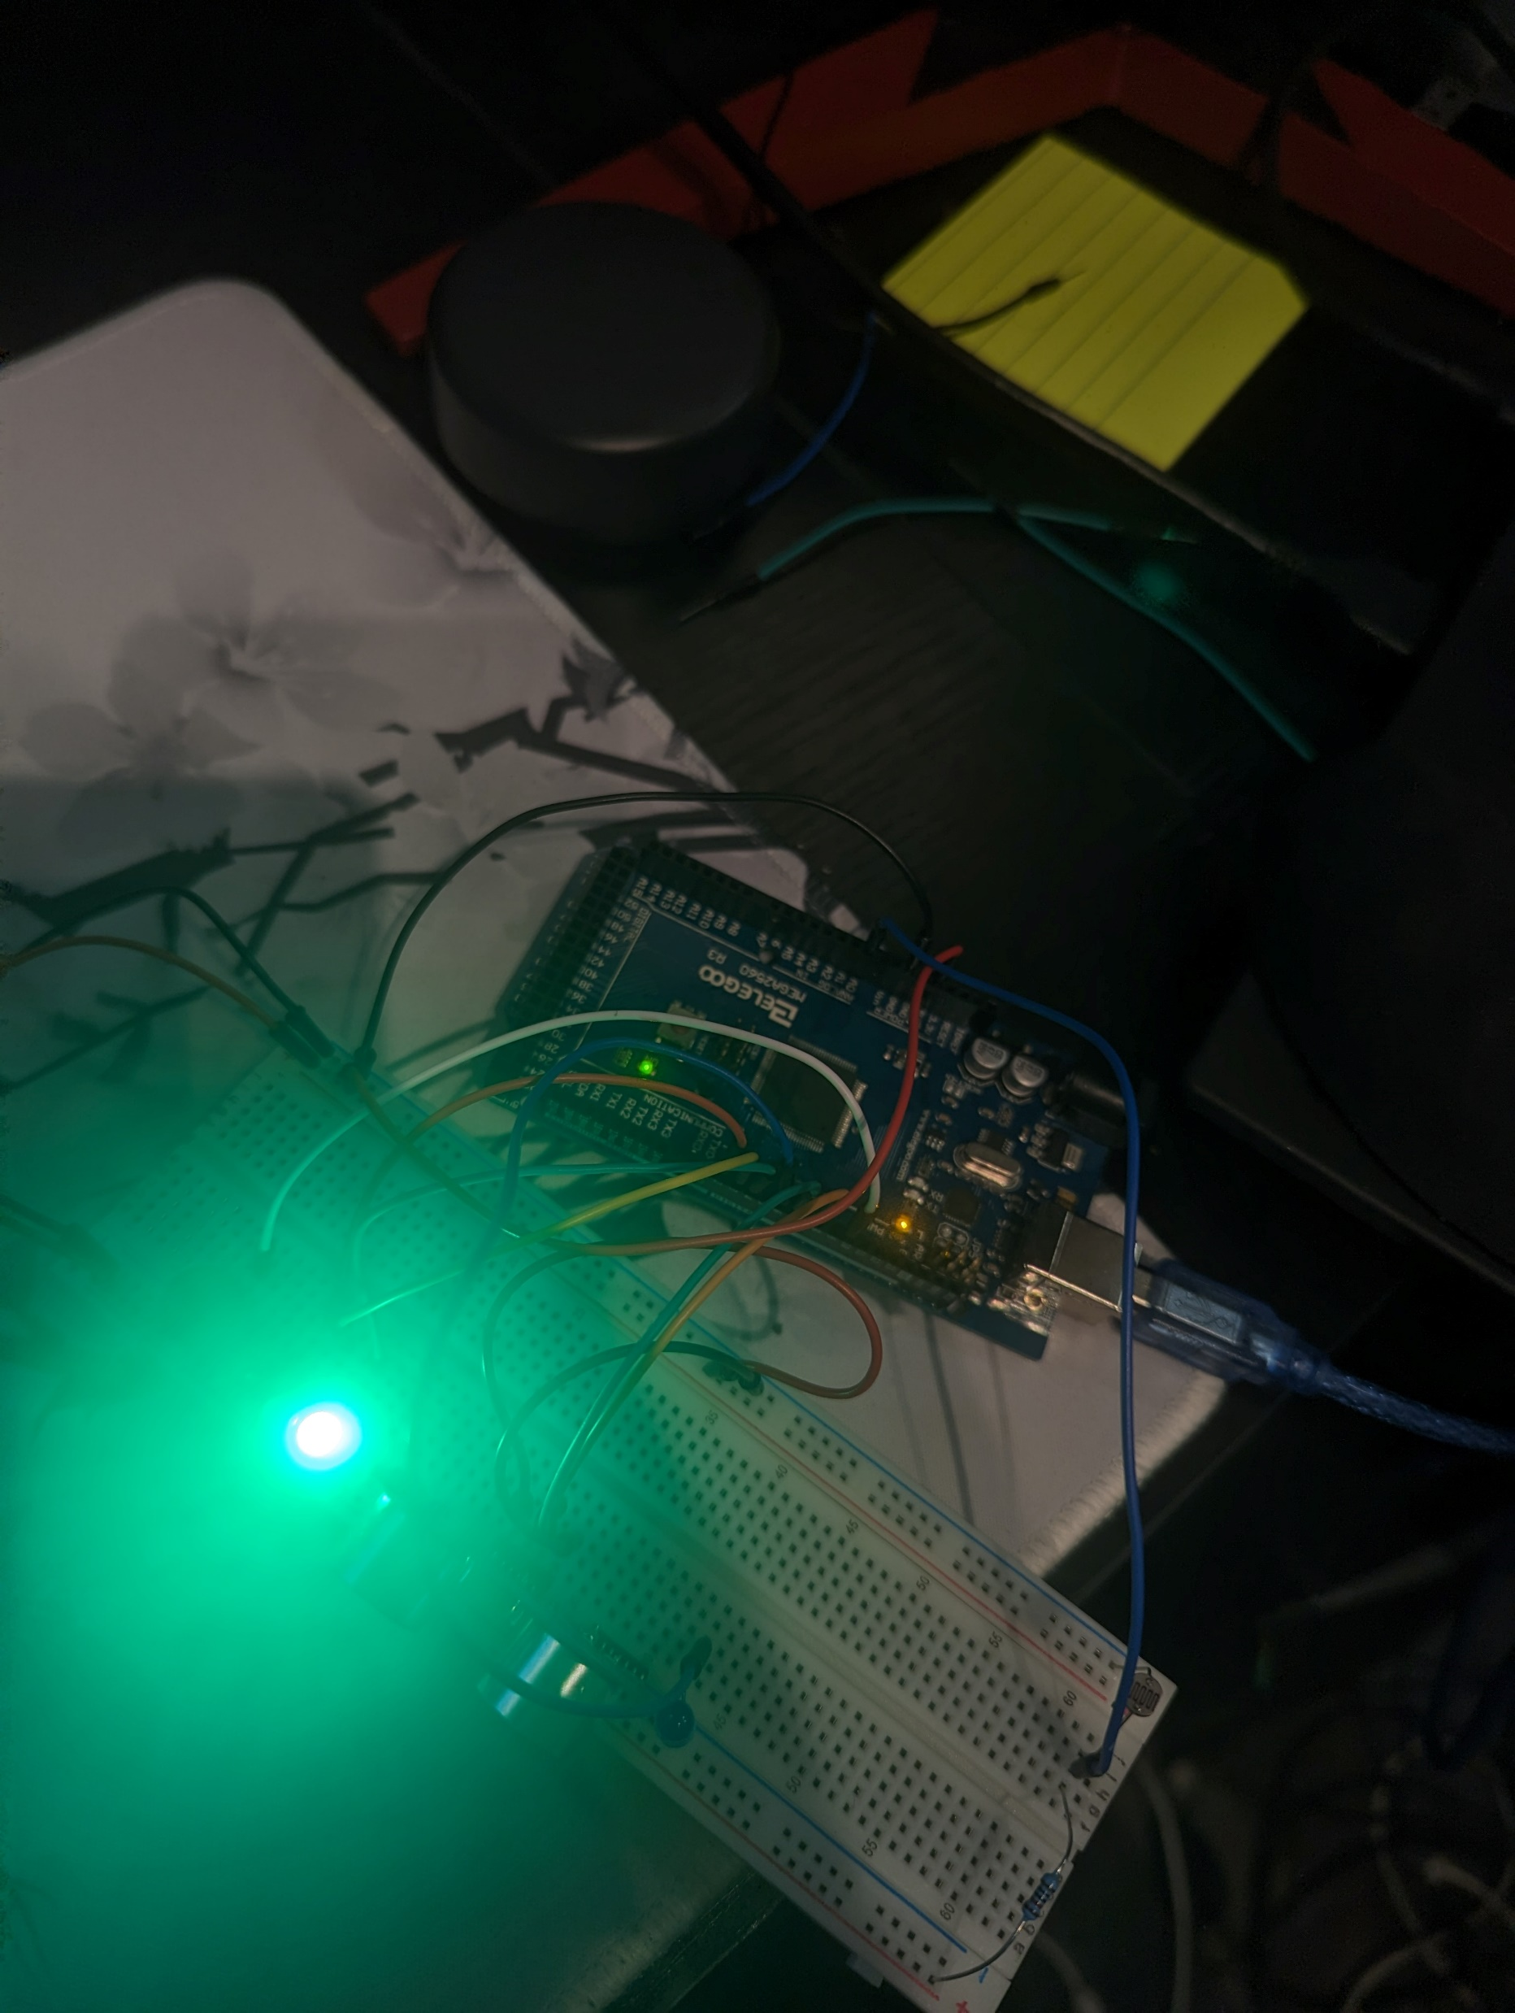
Circuit with automated led off (picture)

Slide 20
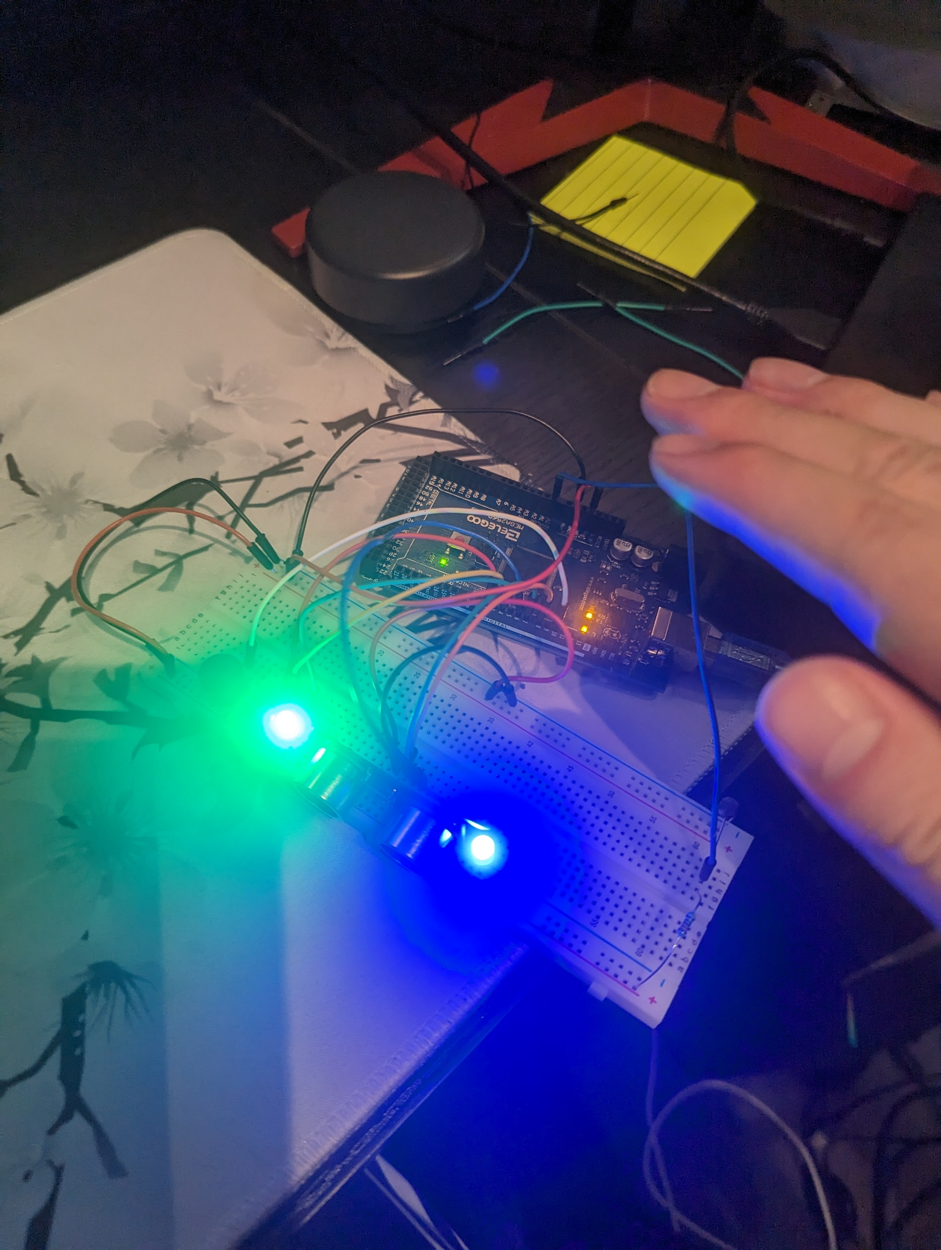
Circuit with automated led on (picture)

Slide 21
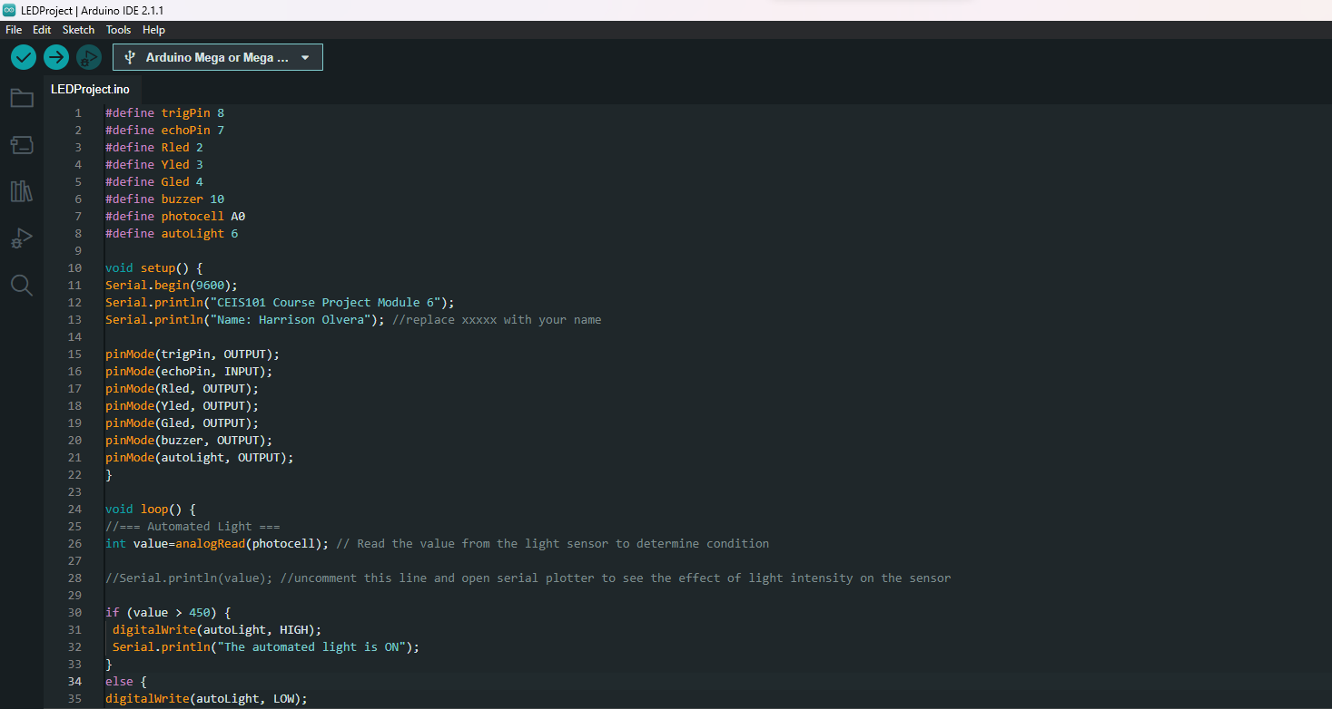
Arduino code (screenshot)

Slide 22
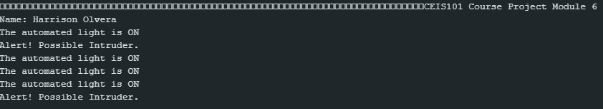
Serial monitor (screenshot)

Slide 23
Challenges/Lessons Learned
What challenges did you face while working on the project?
Trying to find out where to place the ground pin to power the device.
How did you overcome these challenges?
By testing in Tinkercad I was able to find out the proper place to put the 5v and ground pins.
What lessons did you learn?
How to code an automated device
How to graph data outputted from the serial monitor
How to physically build an automated home system

Slide 24
Career Skills
What skills did you develop to benefit your career?
Troubleshooting
Project Management
Device Integration
Coding

Slide 25
Conclusion
With this project, I have gained a strong understanding of the skills and knowledge needed to create an automated home system. Having the opportunity to gain on hands experience creating an IoT device is truly a blessing. Learning the fundamentals of IoT devices has helped me gain the confidence I need to continue projects like these in the future.

Slide 26
References
Devry University project instructions and walkthrough videos

